Slide 1

Measurable Skill Gain
Wioa Title 1 training video series – April 2021
Notes:
Welcome back to the WIOA Title I Training Video Series

Slide 2
WIOA Title I Training Series
Clarifying Expectations and Key Takeaways
Individual Employment Plan
Measurable Skill Gains
Work Experience
Exit
Individual Service Strategies
Credential Attainment
Follow-up Services (Youth)
Notes:
This training series focuses on seven specific topics that are key to successful implementation of WIOA programs. This training focuses specifically on Measurable Skill Gain.

Slide 3

https://www.nj.gov/labor/wioa/resources/
Notes:
You can find New Jersey’s Measurable Skill Gains policy in the Workforce Professional Resources section of the NJ WIOA website.

Slide 4
https://www.nj.gov/labor/wioa/resources/
Notes:
All policies that have been issued by NJDOL are available in the NJ Workforce Innovation Notices section.

Slide 5
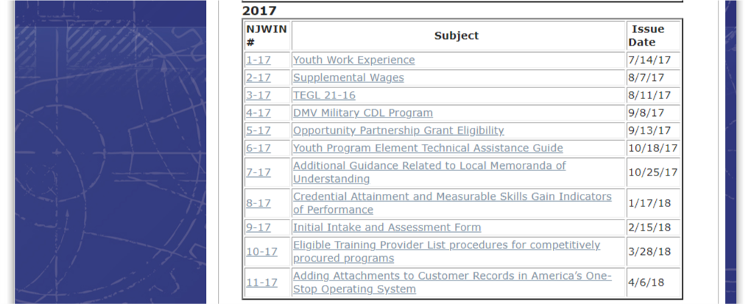
https://www.nj.gov/labor/wioa/resources/
Notes:
Including specifically the Measurable Skill Gain policy, NJWIN 8-17.

Slide 6
Measurable Skill Gain
Measurable Skill Gain: Incremental Measures of Progress and Development
Measurable Skill Gains measure the interim progress of participants who are enrolled in education or training services. MSG is a real-time, in-program measure intended to capture important progressions through pathways that offer different services based on program purposes and participant needs.
Measurable Skill Gains are relevant across a variety of education and training programs:
Basic Literacy
English Language Learning
Secondary School
Vocational Training
Post-secondary School
On-the-Job Training
High School Equivalency
Apprentice-ship
Notes:
Measurable Skill Gains measure the interim progress of participants in acquiring knowledge and skills among individuals who are enrolled in education or training services; this measure is intended to capture important progressions within a variety of educational opportunities available through WIOA.
From basic literacy and numeracy programs focused on academic development to on-the-job training opportunities that support individuals occupational skills development in an employment setting, and across various secondary and post-secondary programs, measurable skill gains offer an opportunity for getting credit for knowledge and skill development of participants.

Slide 7
Measurable Skill Gain
Measurable Skill Gains are relevant across a variety of education and training programs:
Basic Literacy
English Language Learning
Secondary School
Post-secondary School
Vocational Training
On-the-Job Training
High School Equivalency
Apprentice-ship
Educational Functioning Level
Training Milestone
Diploma or Recognized Equivalent
Exam Passed
Report Card or Transcript
Notes:
WIOA includes five types of Measurable Skill Gains that define skill gains across these different education/training pathways.
1. An increase in educational functioning level
2. Attainment of a secondary school diploma or recognized equivalent
3. Report cards or transcripts demonstrating progress in secondary or post-secondary programs
4. Training milestones specific to Apprenticeship and On-the-Job Training
5. Passage of exams We’ll spend time diving into each of these areas.

Slide 8





Education Functioning Level
Achievement of at least one educational functional level for participant receiving instruction below the post-secondary level
Evidence
Documentation
Basic skills pre-and post test demonstrating achievement of at least on EFL
Approved basic skills test results
Award of credits or units towards secondary diploma or HSE
Letter from educational provider
Official transcript
Enrollment in post-secondary education or training
School enrollment or registration
Class schedule
Notes:
Educational Functioning Level (EFL) is defined as documented achievement of at least one educational functional level of a participant who is receiving instruction below the post-secondary education level.
EFL may be measured by the following:
A basic skills pre and post-test which demonstrates an advancement of an educational level, which can documented with results from an approved basic skills pre-and post-test (e.g., CASAS) showing at least one educational functioning level within the program year.
The award of credits or units towards a secondary school diploma or its recognized equivalent among individuals attending a secondary school program. Documentation includes official transcripts and report cards or a letter from an educational provider.
Enrollment in post-secondary education or training (among specifically individuals who exit the program below the post-secondary level). This can be documented through a school enrollment or registration form, or a copy of a class schedule.

Slide 9


Diploma or Recognized Equivalent
Attainment of a secondary school diploma or recognized equivalent
Evidence
Documentation
Secondary school diploma or HSE
High school diploma
Official secondary transcript
Passing scores
on all HSE sections
Notes:
Attainment of a secondary school diploma or recognized equivalent is the second type of measurable skill gain. This can be documented with a high school diploma, an official secondary transcript, or certification of passing scores on all HSE sections.

Slide 10
Report Card or Transcript
Secondary or post-secondary report card or transcript that shows a participant is meeting academic standards
Evidence
Documentation
Secondary transcript or report card demonstrating achievement of passing grades of D or above
Official transcript or report card
Post-secondary transcript or report card demonstrating achievement of credits and good academic standing
Official transcript or report card
Notes:
In addition, Measurable Skill Gain can also be demonstrated as academic progress in secondary or post-secondary programs through a report card or transcript for one semester showing that a participant is meeting the State unit’s academic standards.
At the secondary level, this includes providing a transcript or report card that demonstrates achievement of passing grades of D or above in a specific semester.
At the post-secondary level this includes providing a report card or transcript that demonstrates that full-time or part-time credit levels were achieved in a semester based on a participant’s enrollment status.

Slide 11

Training Milestone
Satisfactory or better progress towards established milestones from an employer or training provider
Evidence
Documentation
A satisfactory or better progress report towards established OJT or Registered Apprenticeship milestones
Progress reports towards established training milestones
Passage of exams demonstrating competency or for credentialing
Notes:
The fourth type of Measurable Skill Gain is a training milestone – which is specific to OJT and Registered Apprenticeship opportunities. A training milestone is defined as satisfactory or better progress towards established milestones from an employer or training provider. Progress reports and passage of specific exams can demonstrate training milestones. What is most important here is that local offices work and collaborate with employers and providers providing Apprenticeship and OJT opportunities to establish specific milestones as part of their contract.

Slide 12
Exam Passed
Passage of an exam required for a particular occupation or progress in attaining technical skill as demonstrated through a trade-related benchmark
Evidence
Documentation
Passing score for a knowledge- based or completion test necessary to obtain a credential for an occupation
Passage of required knowledge-based example demonstrating progress
Passage of completion exam required for credentialing
Notes:
The last type of Measurable Skill Gain relates to passage of exams that are required for a particular occupation or progress in attaining technical or occupational skills as demonstrated through a trade-related benchmark. Participants demonstrating passing scores on knowledge-based or completion tests that are necessary to obtain a credential for an occupation count towards Measurable Skill gain. While completion exams are the clearest example, a training sequence may also include other knowledge-based exams that demonstrate progress necessary for a particular occupation.

Slide 13
MSG Performance
Participants who are currently attending a training or educational program (including all in-school youth) are included in the MSG performance measure.
Measurable skill gain is a measure based on who participates in training and educational programs each program year.
Skill gains should be documented as soon as an MSG is achieved during the program year.
Once a Measurable Skills Gain is documented for the current program year, no other achievement will count towards MSG performance, even if the participant enrolls in another education or training activity during the program year.
If the participant’s enrollment in education or training carries over into a new program year, a skills gain must also be documented for the new program year.
Notes:
A couple additional notes about Measurable Skill Gain Performance.
Participants who are currently attending a training or educational program (including all in-school youth) are included in the MSG performance measure
MSG is a measure based on who participates in training and educational programs each program year.
For this reason, skill gains should be documented as soon as an MSG is achieved during a program year.
Once a Measurable Skills Gain is documented for the current program year, no other achievement will count towards MSG performance for that individual, even if the participant enrolls in another education or training activity during the program year.
If the participant’s enrollment in education or training carries over into a new program year, a skills gain must also be documented for the new program year.

Slide 14
Additional Notes
For Individual Training Accounts (ITA) and Customized Training, the documentation of attainment of skills progression must be completed by the training provider or employer.
Individuals who receive only incumbent worker training are not included in WIOA performance indicator calculations. However, State and local areas are still required to report participant and performance data on all individuals who receive only incumbent worker training, which includes the MSG performance indicator
Notes:
A couple last notes about the Measurable Skill Gain policy:
For Individual Training Accounts (ITA) and Customized Training, the documentation of attainment of skills progression must be completed by the training provider or employer.
Individuals who receive only incumbent worker training are not included in WIOA performance indicator calculations. However, State and local areas are still required to report participant and performance data on all individuals who receive only incumbent worker training, which includes the MSG performance indicator.

Slide 15
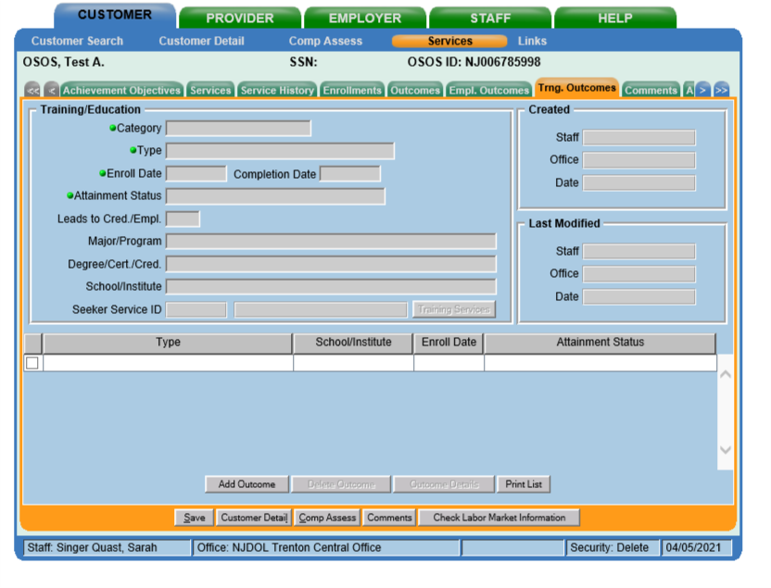
AOSOS Roadmap
Measurable Skill Gains
Step 1: Add information about relevant education/training by clicking on the “Add Outcomes” button in the Training Outcomes tab in Services
Notes:
Measurable Skill Gains must be documented in AOSOS. Measurable Skill Gains are entered in the Training Outcomes tab in Services. To add a Measurable Skill Gain - click on the Add Outcomes button.

Slide 16
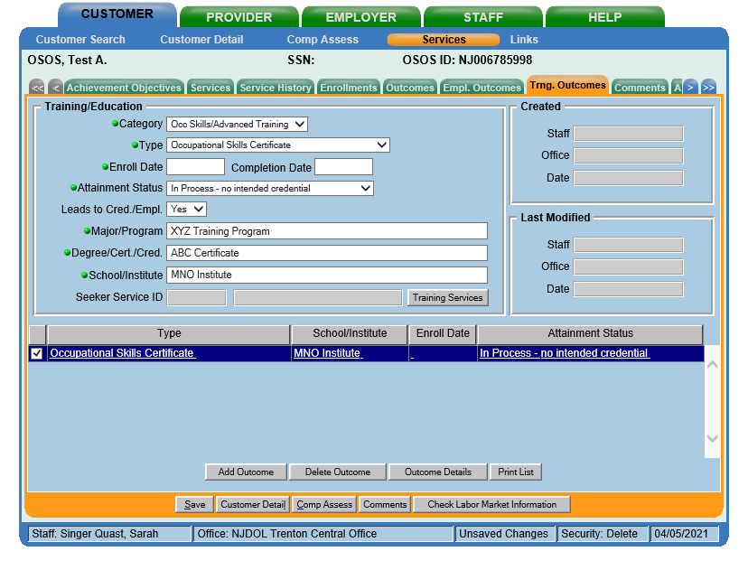
AOSOS Roadmap
Measurable Skill Gains
Step 2: Add information about training/education program in all the fields with green dots
Notes:
Information about the training and education program should be entered in all of the fields with green dots

Slide 17
AOSOS Roadmap
Measurable Skill Gains
Step 3: Click on “Outcome Details” to enter information about Measurable Skill Gain
Notes:
To enter a specific skill gain related to this outcome, click on the outcome details button.

Slide 18
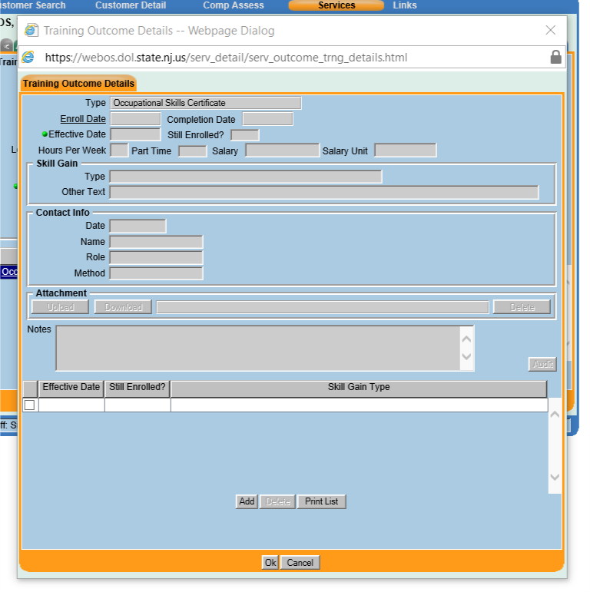
AOSOS Roadmap
Measurable Skill Gains
Step 4: Click on “Add” in Training Outcomes Details box that pops out
Notes:
You will then need to click add on the training outcomes details box that pops up.

Slide 19
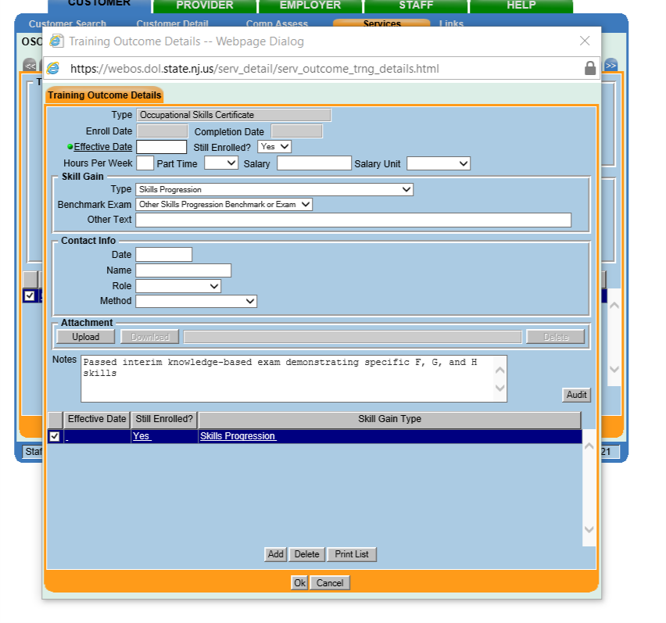
AOSOS Roadmap
Measurable Skill Gains
Step 5: Add information about date and type of Measurable Skill Gain, as well as any relevant details
Notes:
Add specific information about the date, type, and relevant details about the Measurable skill gain.

Slide 20

File Roadmap
Measurable Skill Gain – Local Documentation
Additional Documentation
Basic skills test results
Official secondary or post-secondary report cards and transcripts
Postsecondary enrollment or registration forms
High school diploma
HSE exam results
Results from occupation-specific exams
Other MSG relevant documents.
Notes:
In addition to documentation in AOSOS, specific documents and documentation related to the Measurable Skill gain highlighted in this video should be included in the paper file or as uploaded attachments in AOSOS. As discussed in this video, this can include a variety of documents.

Slide 21
Additional Resources
NJDOL Policy
NJ Workforce Innovation notices including NJWIN 8-17 that outlines specific Measurable Skill Gain policy can be found here:
https://www.nj.gov/labor/wioa/resources/
AOSOS Training Videos
Specific tutorials about entering Activities and Comments, the tabs in Customer Detail, and the tabs in Comp Assess can be found here: https://towork.dol.state.nj.us/aosostrainingmaterials/_layouts/15/start.aspx#/
Workforce GPS
Additional resources about Measurable Skill Gain can be found on DOLETA’s Workforce GPS website: https://performancereporting.workforcegps.org/resources/2018/07/30/12/57/Measurable-Skill-Gains-E-Learning-Module
Contact us at Career Services with any questions at WIOApolicy@dol.nj.gov
Notes:
This concludes our summary of Measurable Skill Gain. Additional resources including NJDOL’s policies, a series of training tutorials on AOSOS, as well as work experience materials on Workforce GPS may help to augment knowledge of concepts highlighted in this training. If you don’t have access to these materials or have any additional questions, don’t hesitate to reach out to us at WIOApolicy@dol.nj.gov. Also, don’t forget to subscribe to this YouTube channel for information about future videos, just click on the subscribe button. Thank you.

